Slide 1
The Educational Research Alliance of Northern Virginia at George Mason University Chronic Absenteeism Panel & Discussion
January 29, 2024
Notes:
Reminder of purpose: this is our time to have real time conversations with takeaways
This idea, the Elephant in the Room discussion, was generated in one of our CEHD meetings—having honest conversation around these incredibly pressing issues that are sitting right in front of us
In fact, we have this amazing group of educators and leaders in one space. It almost seems egregious not to leverage the energy and expertise in the room
This is what we hope makes our partnership different. In each of our meetings we want to take a swing at one of these acute challenges.
Today, we have a special panel convened to tackle an elephant we know has come to many of your rooms, or classrooms as it were.

Slide 2
Chronic Absenteeism - Panel Members
Michael S. Axler, Psy.D
Director, Intervention and Prevention Services, Fairfax County Public Schools
Laura Thieman, LCSW, MPH
Manager, Student Attendance & Engagement, Fairfax County Public Schools
Dr. Marcella P. Simmons
Assistant Principal, Robert E. Aylor Middle School, Frederick County Public Schools
Timothy Kasik
Principal, Mount Daniel Elementary School, Falls Church City Public Schools
Sarah Coughter
Social Worker, Mount Daniel Elementary School, Falls Church City Public Schools
Dr. Thomas Taylor
Superintendent, Stafford County Public Schools
Alyssa Barone, Phd Student
George Mason University
Moderator: Anne Holton
Professor of Education Policy, George Mason University
Notes:
Anne

Slide 3
Falls Church City Public Schools
Timothy Kasik
Principal, Mount Daniel Elementary School
Sarah Coughter
Social Worker, Mount Daniel Elementary School

Slide 4
Falls Church City Public Schools
Tim Kasik, Principal
Sarah Coughter, School Social Worker

Slide 5
What are we doing at FCCPS?
VDOE has asked all of us to look at absenteeism differently
Communication to families (from whole division and individual schools)
Creation of a division wide attendance task force
Paying attention to the importance of parent relationships and our unique ability to connect with families throughout our students’ entire K-12 career

Slide 6
Stafford County Public Schools
Dr. Thomas Taylor
Superintendent

Slide 8
Fairfax County Public Schools
Michael S. Axler, Psy.D
Director, Intervention and Prevention Services
Laura Thieman, LCSW, MPH
Manager, Student Attendance & Engagement

Slide 9
Student Attendance & Engagement
2023-2024
Notes:
Intro Slide
Brief overview of FCPS https://www.fcps.edu/about-fcps FCPS serves a diverse student population of more than 181,000 students in grades prekindergarten through 12, speaking over 200 languages. Over 27% of our total student population is economically disadvantaged; 14.4 percent are reported as students with disabilities and more than 20% of students are English Learners.
Supporting student attendance and engagement is an integral part of our Strategic Plan, where every student feels safe, supported, included and empowered.
https://www.fcps.edu/strategic-plan
Goal # 2 - Safe, Supported, Included and Empowered
Every student will experience an equitable school community where student health and well-being are prioritized, and student voice is centered.
What is the relationship between absences and equity? Absenteeism is a leading indicator and cause of educational inequity.

Slide 10
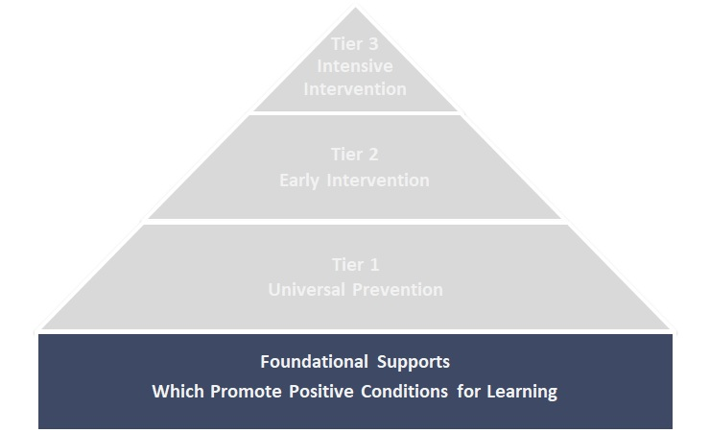
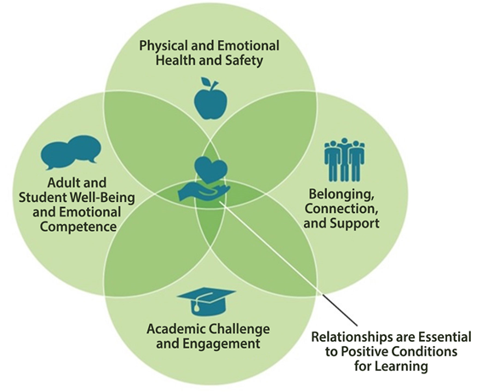
Foundational Supports: Positive Conditions for Learning
Restorative check-ins
Access to health care & mental health supports
Trauma-informed practice
Staff self-care
Healthy learning environments
Welcoming, safe school climate
Access to food & other basic needs
Access to tech & internet
Learning supports
Project-based learning
Credit recovery opportunities
Internships/community service
Alternative scheduling options
Active student & family engagement
Advisories/meetings to build community
Enrichment & clubs
Positive peer connections
Notes:
Mike
Reflection moment on locus of control vs. “this is a student or family problem” and how these strategies are within our control in the school system.
Also a shift away from punitive to compassion, sensitivity and partnering
For example, how each student is welcomed / greeted each day, having proactive teaming structures to monitor and respond to attendance data, understanding and addressing the root causes of absenteeism in partnership with families.
Clear, concise and consistent communication about schedules and expectations, Routines, rituals and celebrations related to attendance and engagement, Personalized positive communication to families when students are absent, Recognition of good and improved attendance, Impact of attendance on whole child widely understood, Connection to a caring adult in the school, Every child and their family encouraged to develop a success plan that includes attention to attendance
Tier 1 represents universal strategies to encourage good attendance for all students. These include recognition of good and improved attendance, connecting all students to a caring adult in the school, and personalized positive communication to families when students are absent.
The foundational supports that FCPS provides to promote positive conditions for learning fall into four categories:
Physical and emotional health and safety
Belonging, connection, and support
Academic challenge and engagement
Adult and student well-being and emotional competence
Examples of the supports provided in each category are noted on the slide. All of these supports are rooted in the understanding that positive relationships are the central ingredient in fostering positive conditions for learning.
Reflection moment on our locus of control within the school division vs. “the problem is the student / family”
Tiered MTSS framework with a dedicated focus on Tier 1 strategies to support a culture of engagement and attendance. Examples of high-leverage strategies::
Proactive and consistent messaging to families regarding attendance expectations and the connection to the overall well-being of their student.
Welcoming / greeting each student each day; a warm welcome back when returning from an absence
Recognizing good and improved attendance
The MTSS Site Intervention team should meet at least twice monthly to use SIS / Attendance dashboard data to identify and monitor students missing 10% or more of the school year, identify root causes and match these to appropriate interventions using the MTSS Attendance Engagement & Strategies guidance.
The Attendance Intervention Job Aid supports school teams with guidance on interventions related to barriers, disengagement, misconceptions and aversions.

Slide 11
Addressing health-related absences
Primary driver of absences
Role of prevention
Need to reset expectations
Clarifying guidance for parents on when to go to school
Strengthening collaboration with school health staff
Inviting partnerships between school, providers and families
Assuming positive intent
Notes:
Laura
Strength of the “When in doubt, keep them out” messaging… association of home is safe and school / outside home is dangerous. Powerful brain and body associations…
Need to create safe and predictable associations with school
Health related barriers → connecting with public health nurse / addressing lack of medical access, etc.
Return to learn - mini return to learn moments
“Late is great” Appointments should be at beginning or end of day. Many families feel that since the child would miss part of the day, they should come miss the whole day of school.
https://www.attendanceworks.org/partnering-with-families-and-health-providers-to-reduce-health-related-absences/
Strengthen partnership with school health to include data sharing and increased collaboration and teaming structures - including the public health nurse when students have reached a certain threshold of health-related absences

Slide 12
Attendance Dashboard
Track and analyze district, school, and student-level attendance data
Facilitate early identification of students at risk for chronic absenteeism
Contribute to integrated data dialogues to support a whole-child lens
Monitor attendance data and respond to patterns and trends
Engage in root cause analysis to match attendance barriers with interventions
Inform the provision of universal, targeted, and intensive supports and services
Guide staff in recognizing good and improved attendance
Notes:
Laura

Slide 13
Frederick County Public Schools
Dr. Marcella P. Simmons
Assistant Principal, Robert E. Aylor Middle School

Slide 14
Robert E. Aylor Middle School, Frederick County, Va Relationships, Relationships, Relationships
Tier 1:
Spartan “SpeaRRR”it
House System
Spartan “SpeaRRR”it lessons every Monday in Spartan “SpeaRRR”it House Groups
Attendance Matters Lesson at the start of the school year (act-it-out and flyer)
PBL focused on improving school culture and climate lead by students in each house
Tiers 2 and 3:
School Counseling Groups focused on the root cause of attendance issues
Attendance meetings with a focus on “How can we support you?”
offering services and supports
Aylor Ambassadors (SAIG)
Check-in/Check-out with individual students

Slide 15
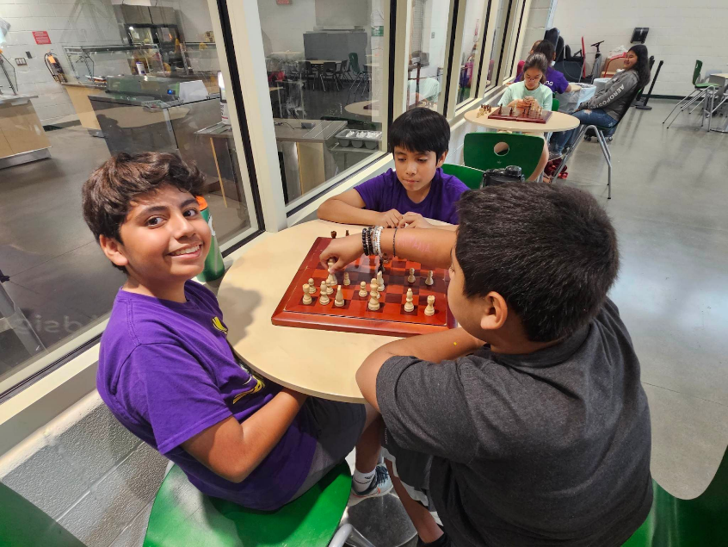
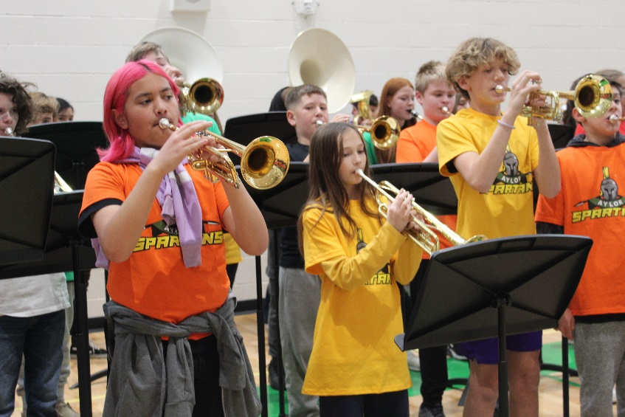
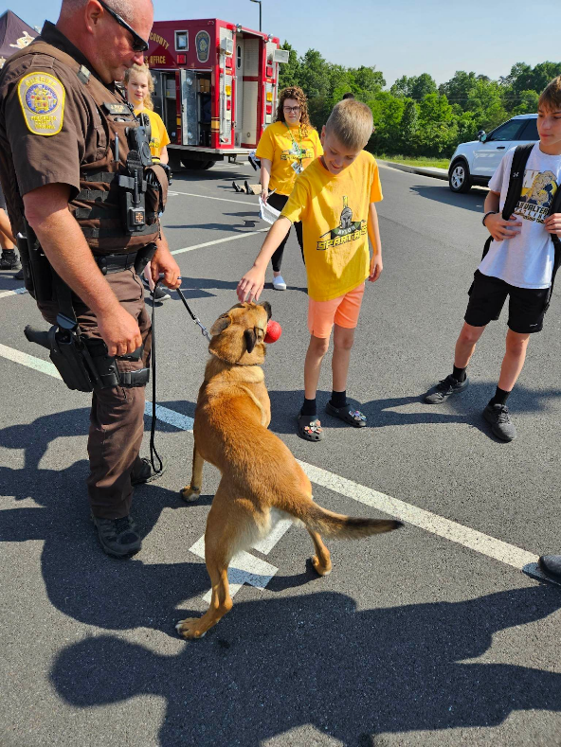
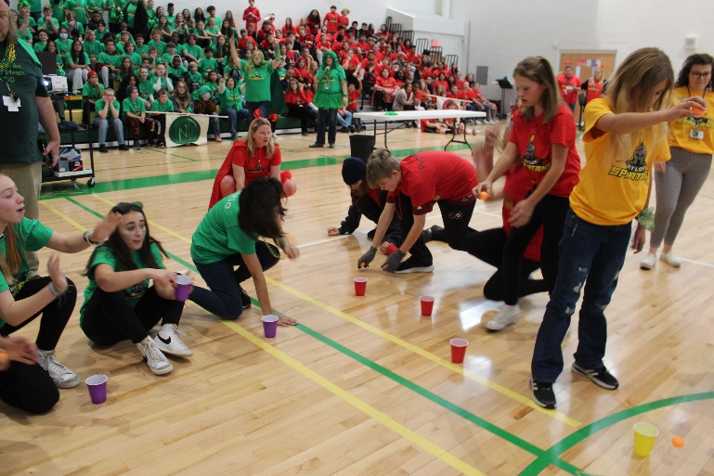
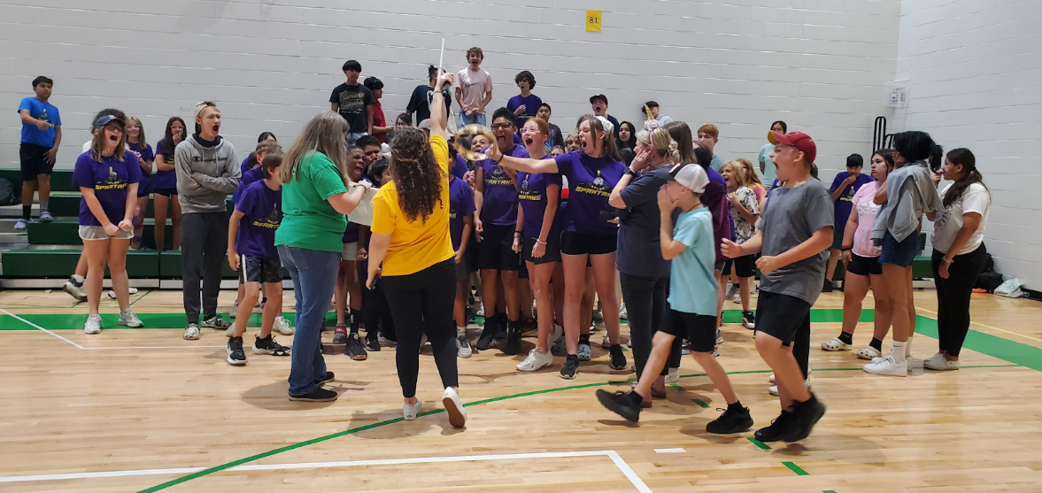

Slide 16
College of Education and
Human Development
Alyssa Barone, Phd Student
George Mason University

Slide 17
Chronic Absenteeism Causal Research
Alyssa Barone and Dr. Seth B. Hunter
College of Education and Human Development
George Mason University
January 29, 2024

Slide 18
Interventions Overview
Mailer
2.4% reduction
$ 0.53/ mailer
2-way messaging
11% reduction
Free on ClassDojo
Social services intervention
6% reduction
$427,000/SY
Public transportation
Breakfast after-the-bell

Slide 19
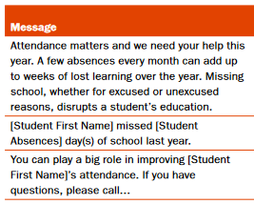
Mailers
Mailing letters to parents with student report cards.
1st-12th grade; Philadelphia; 10 CA school districts (urban, rural, and suburban elementary schools)
Results- 0.5% reduction in Philadelphia; 2.4% in CA
Cost- $0.53/mailer

Slide 20
2-Way text-message
Messaging system was used in 3 different ways
Reminders-parent-teacher conferences, school closed, etc.
Individualized messages- reaching out to parents when a child missed school
Support messages- Encouraging parental engagement in education
Kindergarten; Urban
Results- 11% reduction; 0.30 SD increase end-of-year scores for Hispanic students
Cost- $9,000/SY (AmeriCorps)
ClassDojo is free for all schools!

Slide 21
Social Services Early Intervention
The Truancy Assessment and Service Center (TASC)
Elementary; Southeastern state
TASC procedure
Letter to chronically absent student’s family
Family conference
Family-municipality-school plan
Mental health/educational services majority of referrals
Results- 6% reduction
Cost- $427,000/SY
Notes:
https://nationalgangcenter.ojp.gov/spt/Programs/128

Slide 22
Free Public Transit Yellow School Bus
Student Go-To card
> 2 miles from school OR FRPL
9th-12th grade; Minneapolis
Results- 6% reduction
Cost- City and state funding
There is a negative correlation between kindergarteners taking the bus and absences when compared to other types of transportation
Rural
National sample

Slide 23
Breakfast after-the-bell program
Breakfast served in the classroom; grab-and-go; after first period
3 States more than 50% of student population FRPL
Results- 5% reduction (primarily high school)
Cost-Federal funding through USDA School Breakfast Program grants at qualifying schools
Notes:
https://frac.org/wp-content/uploads/how_it_works_bic_fact_sheet.pdf

Slide 24
Chronic Absenteeism Panel Discussion

